Slide 1
Data Science
Unit-VI
Bayes' Classifier

Slide 2
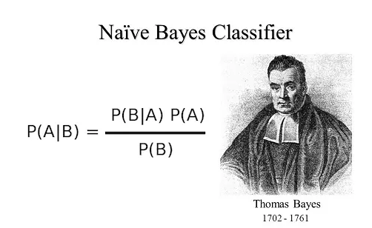
Bayes' Classifier
A Bayes classifier is a probabilistic machine learning model that uses Bayes' theorem to predict the class of a given data point by calculating the probability that it belongs to each class and selecting the class with the highest posterior probability.

Slide 3
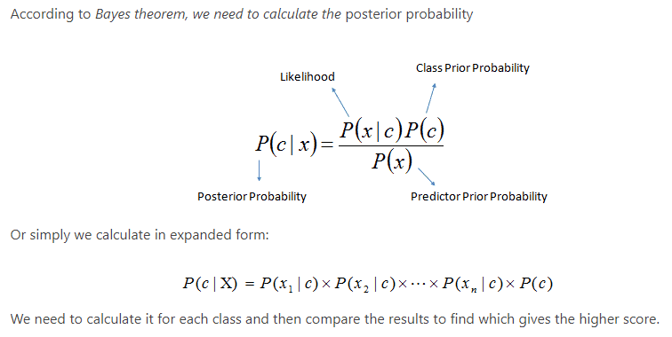
Bayes' Classifier

Slide 4
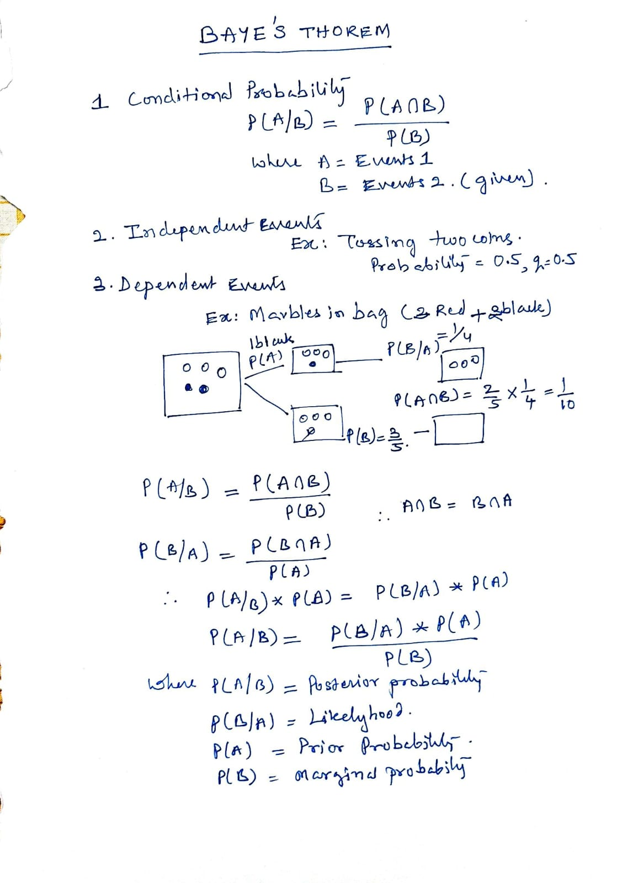

Slide 5
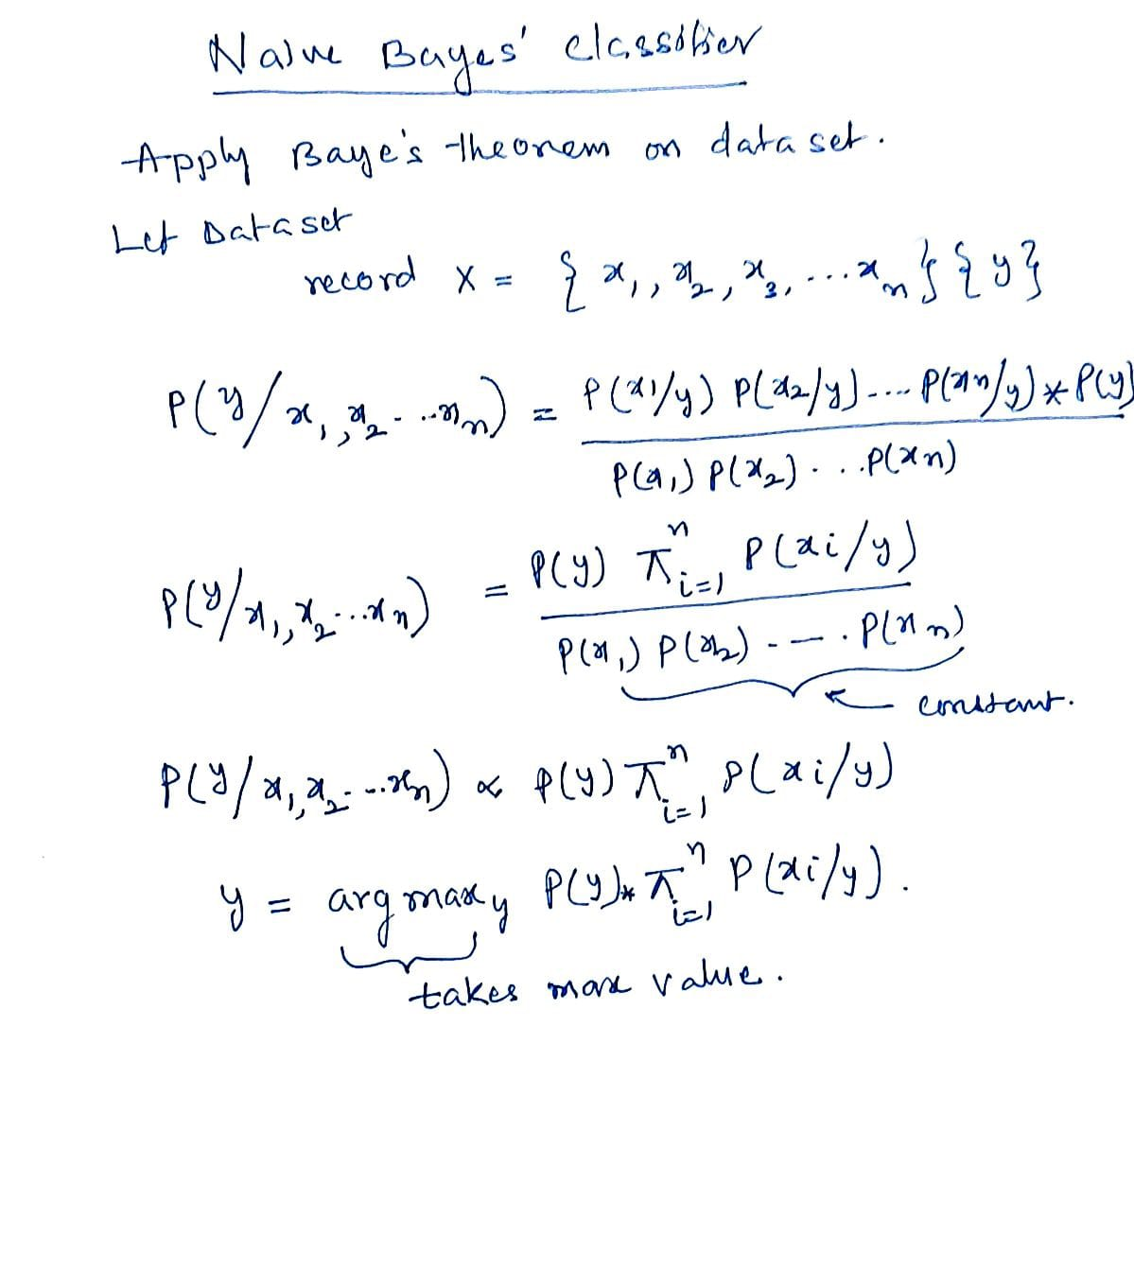

Slide 6
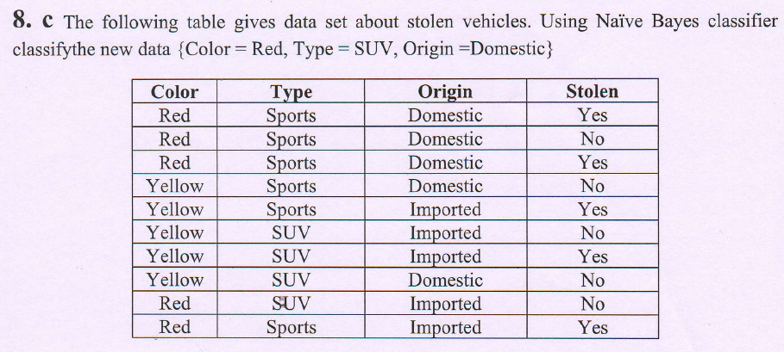

Slide 7
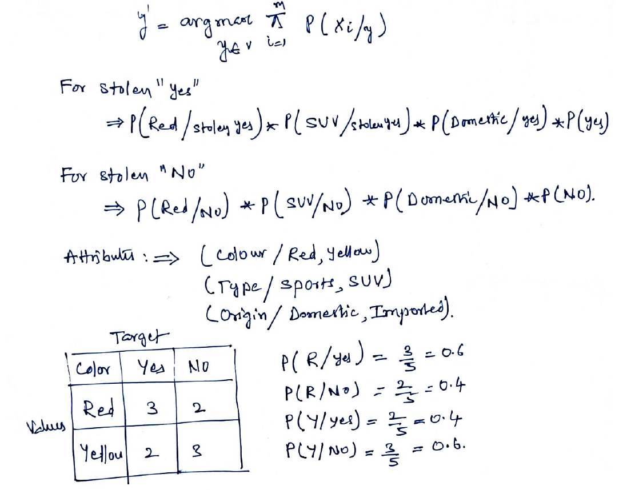
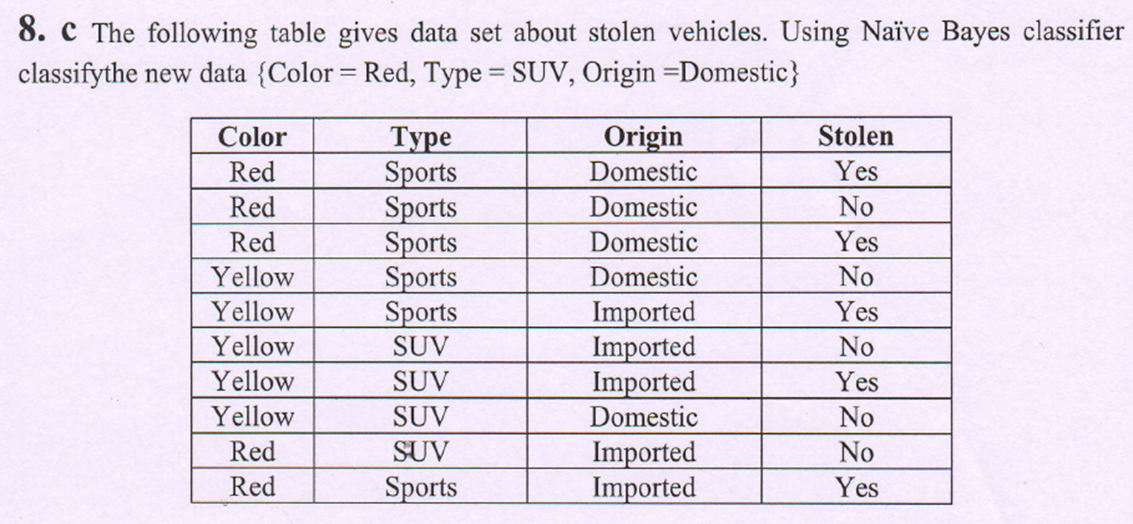

Slide 8
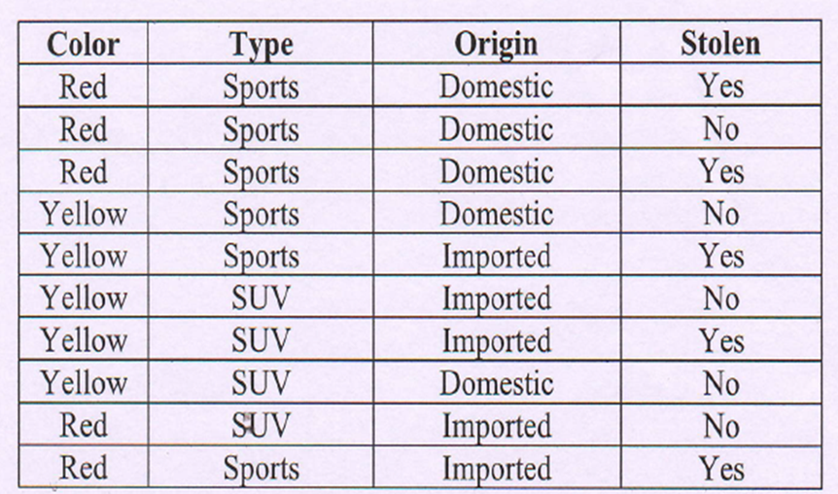
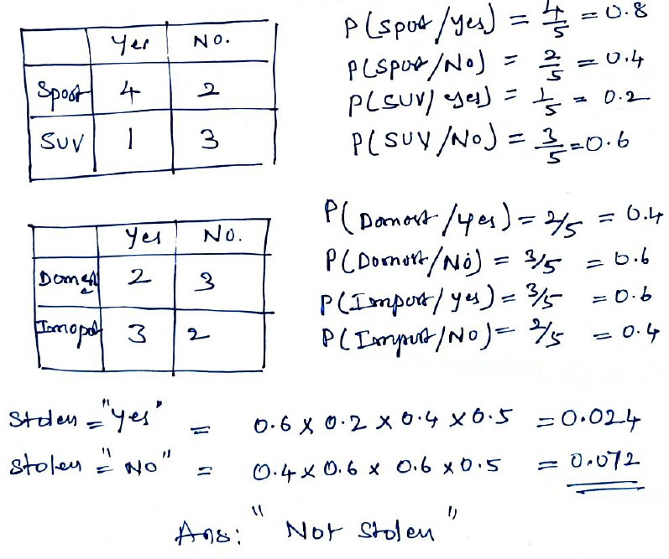

Slide 9
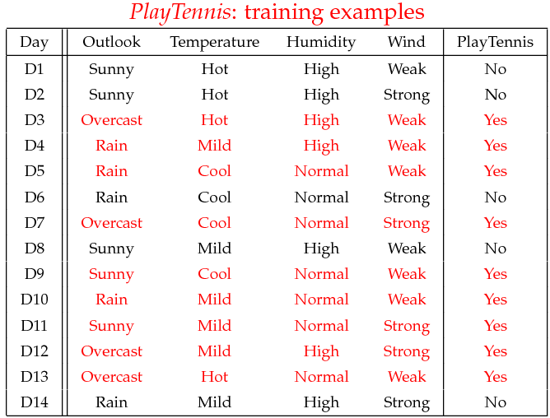
Example

Slide 10
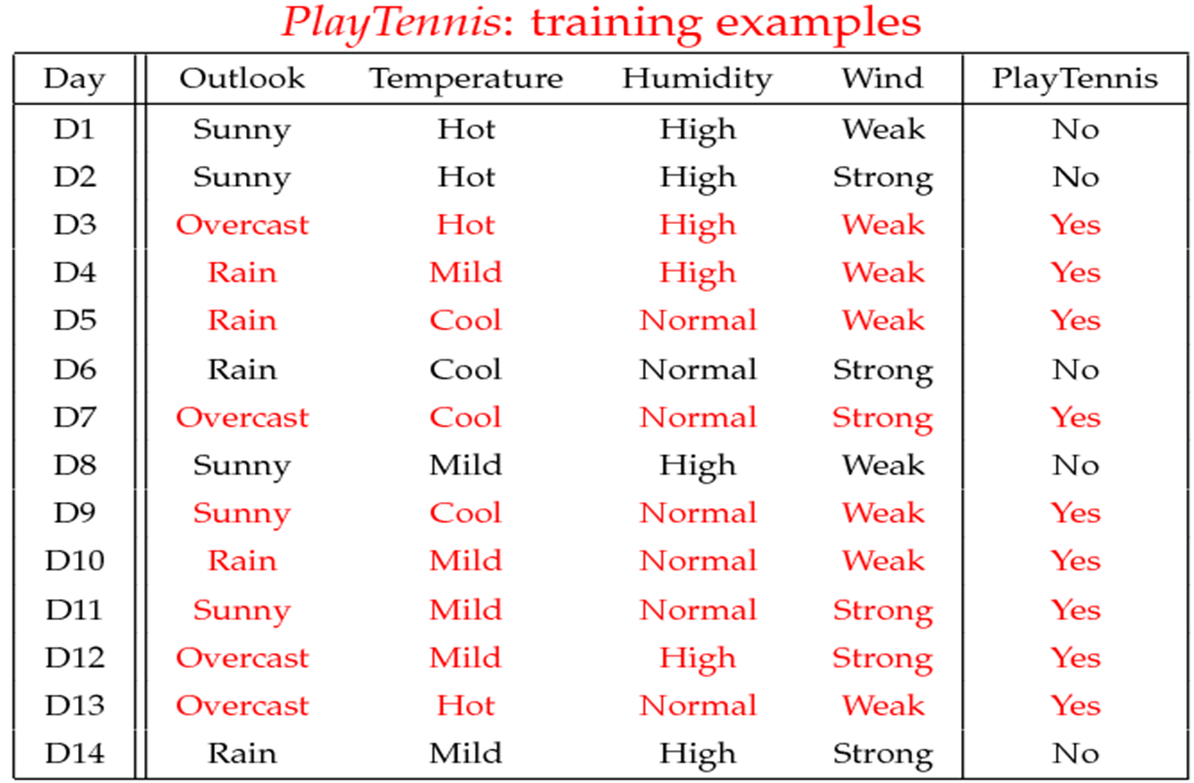
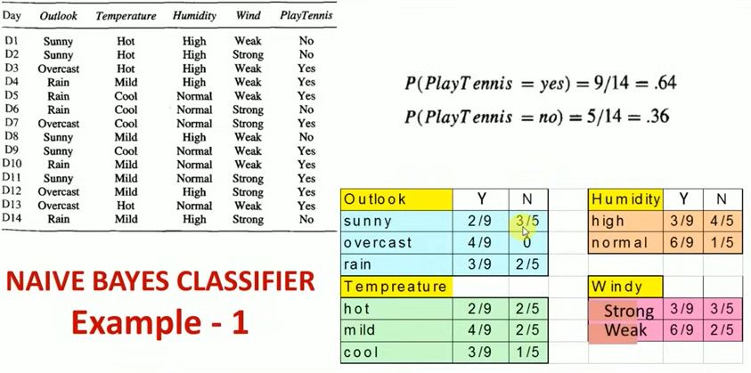

Slide 11
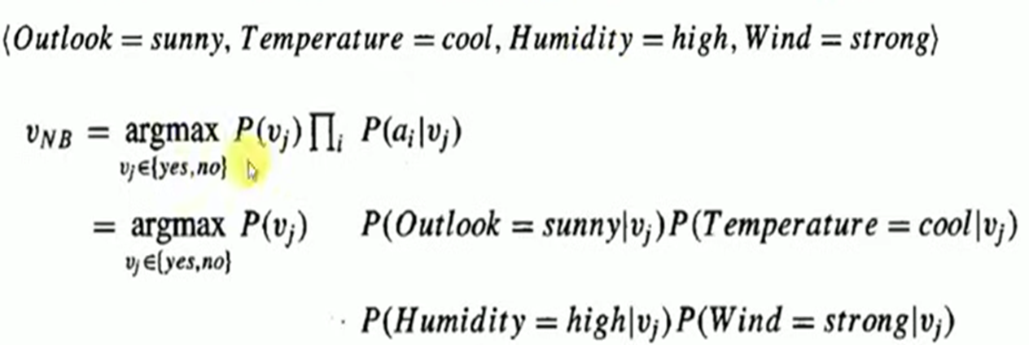
Example
Test Phase: Predict class for instance
  Given a new instance,
  x’=(Outlook=Sunny, Temperature=Cool, Humidity=High, Wind=Strong)
  Look up tables
  MAP rule
P(Outlook=Sunny|Play=Yes) = 2/9
P(Temperature=Cool|Play=Yes) = 3/9
P(Huminity=High|Play=Yes) = 3/9
P(Wind=Strong|Play=Yes) = 3/9
P(Play=Yes) = 9/14
P(Outlook=Sunny|Play=No) = 3/5
P(Temperature=Cool|Play==No) = 1/5
P(Huminity=High|Play=No) = 4/5
P(Wind=Strong|Play=No) = 3/5
P(Play=No) = 5/14
P(Yes|x’): [P(Sunny|Yes)P(Cool|Yes)P(High|Yes)P(Strong|Yes)]P(Play=Yes) = 0.0053
P(No|x’): [P(Sunny|No) P(Cool|No)P(High|No)P(Strong|No)]P(Play=No) = 0.0206
Given the fact P(Yes|x’) < P(No|x’), we label x’ to be “No”.

Slide 12
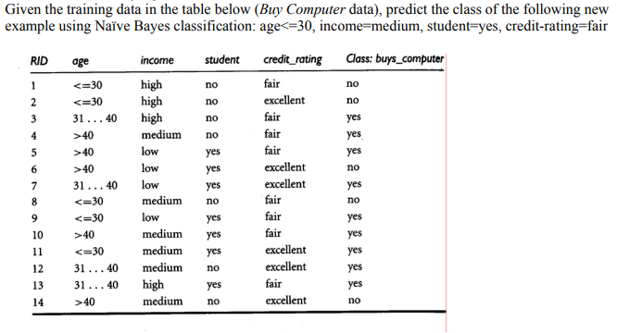
Naïve Bayes Classifier: Example
Class:
C1:buys_computer = ‘yes’
C2:buys_computer = ‘no’
Data to be classified:
X = (age <=30,
Income = medium,
Student = yes
Credit_rating = Fair)

Slide 13
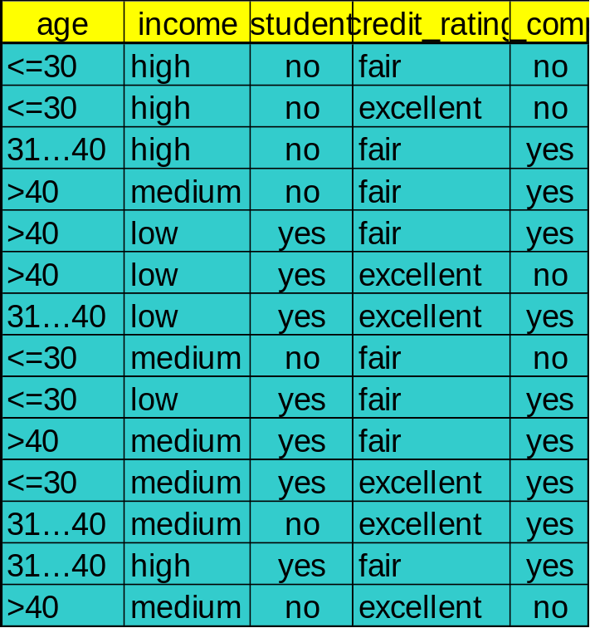
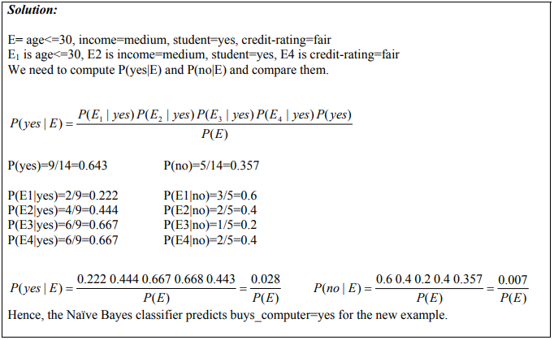
Naïve Bayes Classifier: An Example

Slide 14
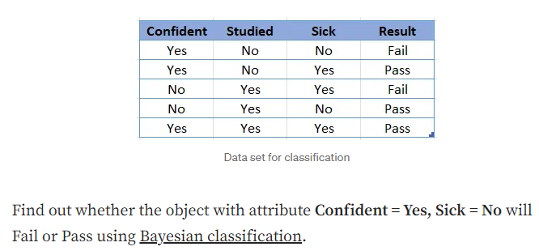
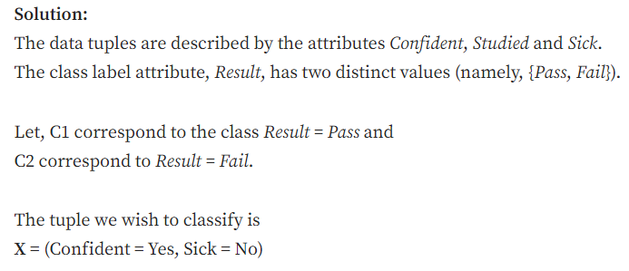
Baye’s Classifier-Example

Slide 15
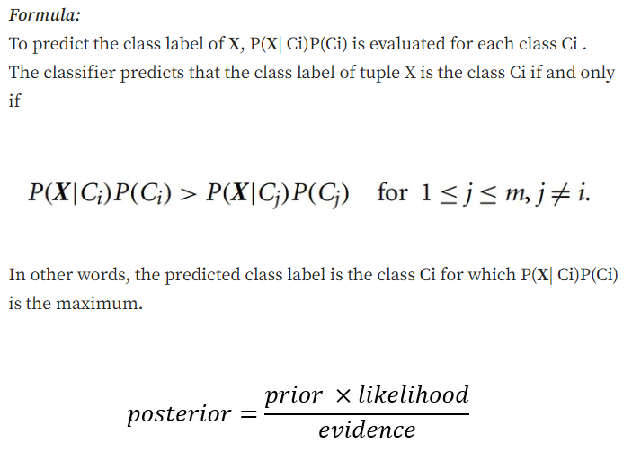
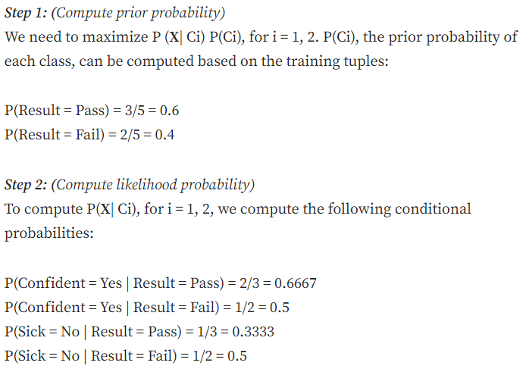

Slide 16
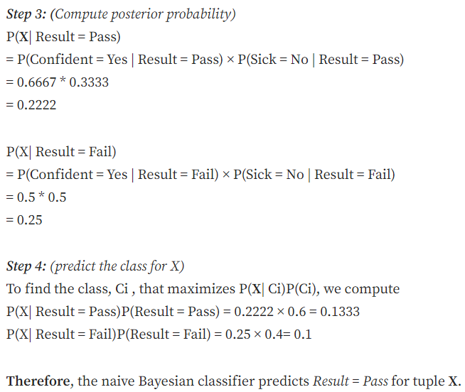

Slide 17
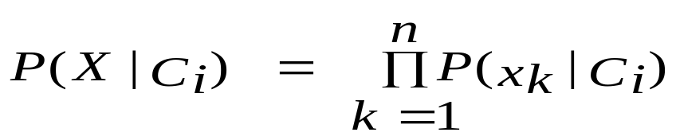
Avoiding the Zero-Probability Problem
Naïve Bayesian prediction requires each conditional prob. be non-zero. Otherwise, the predicted prob. will be zero
Ex. Suppose a dataset with 1000 tuples, income=low (0), income= medium (990), and income = high (10)
Use Laplacian correction (or Laplacian estimator)
  Adding 1 to each case
    Prob(income = low) = 1/1003
    Prob(income = medium) = 991/1003
    Prob(income = high) = 11/1003
  The “corrected” prob. estimates are close to their “uncorrected” counterparts

Slide 18
Advantages of Naive Bayes Classifier
Easy to implement and computationally efficient.
Effective in cases with a large number of features.
Performs well even with limited training data.
It performs well in the presence of categorical features.
For numerical features data is assumed to come from normal distributions
Disadvantages of Naive Bayes Classifier
Assumes that features are independent, which may not always hold in real-world data.
Can be influenced by irrelevant attributes.
May assign zero probability to unseen events, leading to poor generalization.
Applications of Naive Bayes Classifier
Spam Email Filtering: Classifies emails as spam or non-spam based on features.
Text Classification: Used in sentiment analysis, document categorization, and topic classification.
Medical Diagnosis: Helps in predicting the likelihood of a disease based on symptoms.
Credit Scoring: Evaluates creditworthiness of individuals for loan approval.
Weather Prediction: Classifies weather conditions based on various factors.

